Slide 1

Topic F BIG DATA Processing

Slide 2
BIG Data and processing
CONTENT
Big Data Characteristics
Data Engineering challenges with Big Data
Apache Spark
Introduction the Databricks Community Edition environment
Data Analysis using Spark SQL
Reference: Bill Chambers and Matei Zaharia (2018), Spark: The Definitive Guide, O’Reilly

Slide 3
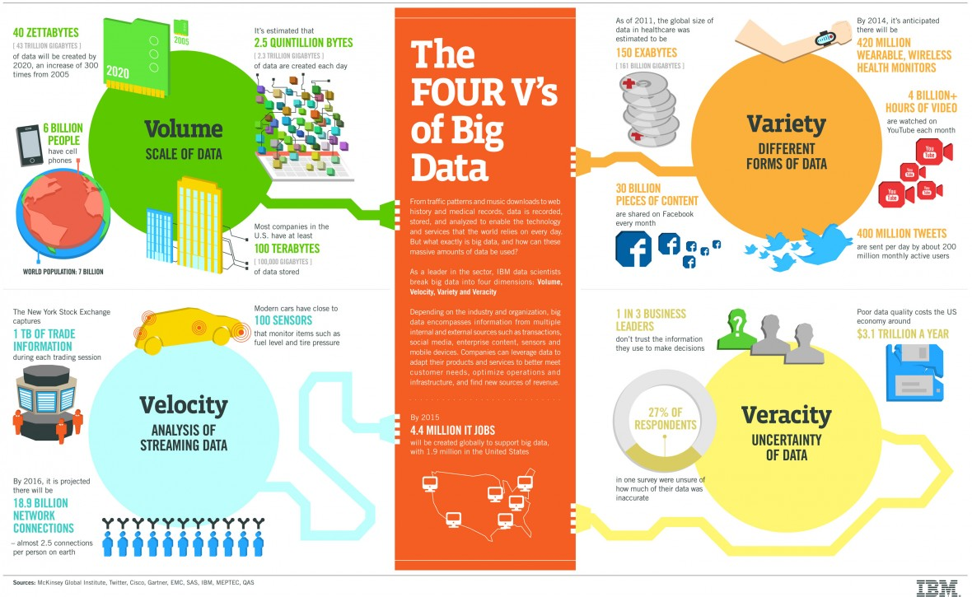
Notes:
Source: https://www.ibmbigdatahub.com/sites/default/files/infographic_file/4-Vs-of-big-data.jpg access on 1 Dec 2019

Slide 4
BIG Data Characteristics
Volume
The size of data sets,
frequently larger than terabytes and petabytes
Velocity
Speed with which data is generated
High velocity data is generated with such a pace that it requires distinct (distributed) processing techniques.
Variety
Big Data comes from a great variety of sources
generally is one out of three types: structured, semi structured and unstructured data
Veracity
The quality of the data
High veracity data has many records that are valuable to analyze

Slide 5
Volume Challenges
Resources Requirement
Need for Scalability in Design
Maintaining Latency
Notes:
Every byte of data needs resources. CPU cycles to process, memory and disc to store, and bandwidth to move. The higher the volume, the more the resources you will need. The challenge starts increasing exponentially when a single processor or pipeline cannot handle the expected volume. This demands building pipelines that can provide horizontal scalability in order to handle volume while maintaining latency requirements.

Slide 6
Speed Challenges
Real-time event data handling
Need for speed
Handling lags
Notes:
Data from browsers, sensors, social media, and mobile phones generating continuous data at alarming volumes. The data processing pipeline needs to keep up with this kind of speed and produce results with low latency. Lags in processing can quickly build up queues that is impossible to catch up. This again calls for parallel transport and computing architectures.

Slide 7
Variety Challenges
Text, audio, video and images
More resources needed
Serving at low latency
Notes:
Unlike old business applications that produce numbers only, the Big Data world produces text, audio, video, and image data. They not only need more resources to store and transport, they also need sophisticated CPU consuming algorithms to analyse and create metrics for different data types. Such resources need to be stored and served also at very low latency.

Slide 8
Variety Challenges
Spikes in load
Decoupling need with buffering zones
Maintaining latency
Notes:
Data from browsers, sensors, social media, and mobile phones generating continuous data at alarming volumes. The data processing pipeline needs to keep up with this kind of speed and produce results with low latency. Lags in processing can quickly build up queues that is impossible to catch up. This again calls for parallel transport and computing architectures.

Slide 9
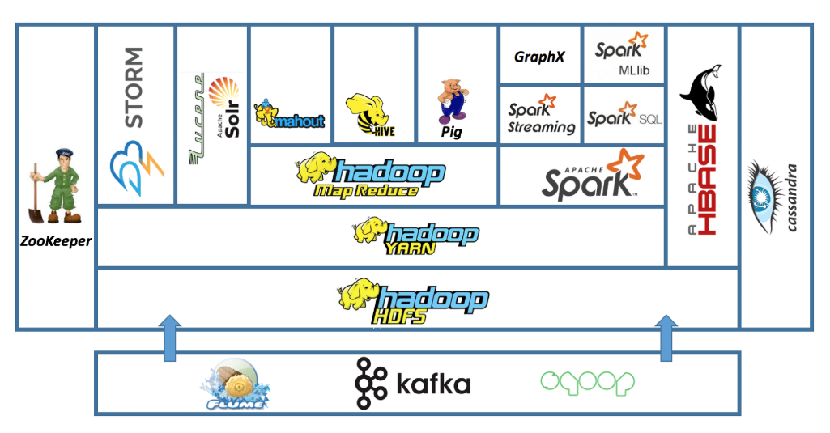
BIG Data Platform: Hadoop
Notes:
Source: https://data-flair.training/blogs/hadoop-ecosystem-components/, access 1 Dec 2019
Source: https://intellipaat.com/blog/tutorial/hadoop-tutorial/introduction-hadoop/, access 1 Dec 2019

Slide 10


Apache SPARK
Speed
Ease of Use
Generality
Platform Agnostics
Managing and coordinating the execution of tasks on data across a cluster of computers.

Slide 11
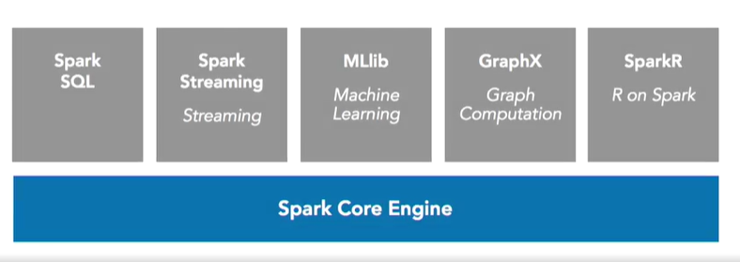
SPARK COMPONETS
Notes:
Spark Core: includes task distribution, scheduling, and the input/output operations.
Spark SQL: allows Data Science professional to do their work in ANSI standard SQL.
Spark Streaming is the component that enables our jobs to process new data as it comes in. To be specific, Spark Streaming runs micro batches, which operate just like normal batch operations, just much more frequently on smaller datasets.
The MLlib component of Spark is what enables our machine learning algorithms to run.
Now GraphX is a way to do graph processing in Spark. I'm not talking about making charts here, but running graph database jobs where you do things like identify relationships between entities in your data and then query that using those relationships.

Slide 12
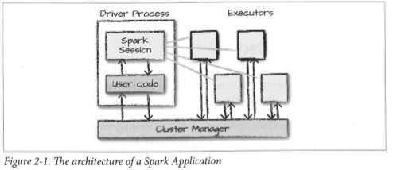
SPARK BAISC Architecture: SPARK application
Source: Spark: The Definitive Guide, Bill Chambers and Matei Zaharia
Notes:
1. Driver Process: sits on a node in the cluster, (a) maintaining information about the Spark Application (b) responding to a user program (c) managing work across executors
2. Executors: carrying the work that the driver assigns to them

Slide 13
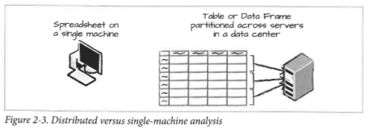
SPARK data frame & partition
DataFrame (Immutable)
Schema
Partition
Source: Spark: The Definitive Guide, Bill Chambers and Matei Zaharia
Notes:
DataFrame: A table of data with rows and columns
Schema: The list that defines the columns and types within those columns
Partition: Spark breaks up the data into chunks called partition. A Dataframe’s partition represent how data is physically distributed across the cluster of machines during execution.

Slide 14
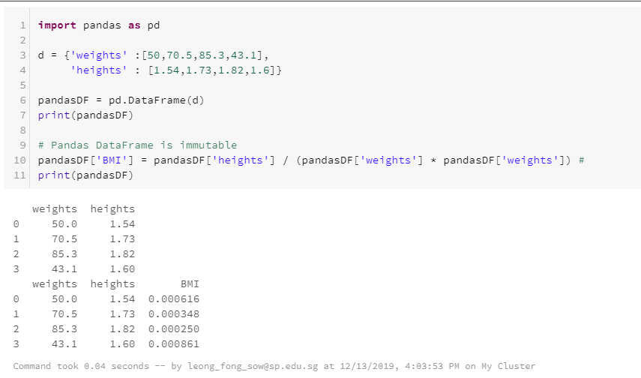
SPARK DATAFRAME vs pandas dataframe
Notes:
Note: Illustration for students with Python Dataframe background
- Pandas DataFrame can be updated.

Slide 15
SPARK Transformation & Action
Transformation
Tell Spark how you would like to modify the data to do what you what.
To build up our logical transformation plan
Spark will not act on transformation until we call an action.
Action
Instruct Spark to compute a result from a series of transform.
Notes:
E.g. Actions: Take, Collect

Slide 16
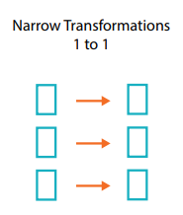
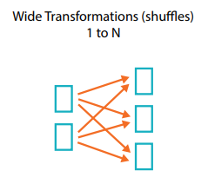
SPARK transformation & ACTION
Narrow Transformation
Each input partition will contribute to only one output partition
Wide Transformation (Shuffle)
input partitions contributing to many output partitions.

Slide 17
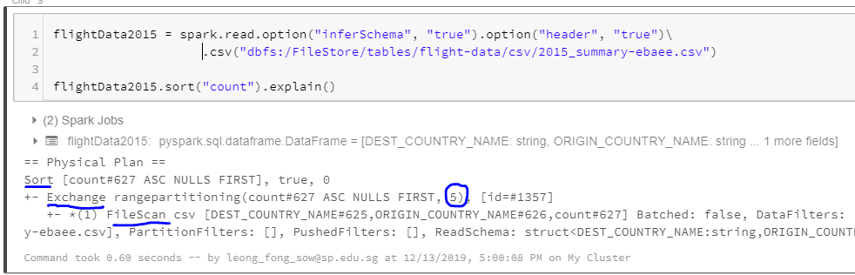
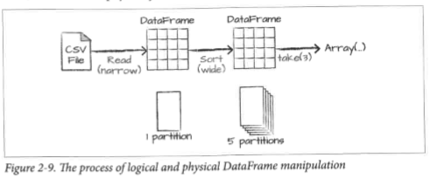
SPARK transformation & ACTION
Transformation Plan

Slide 18
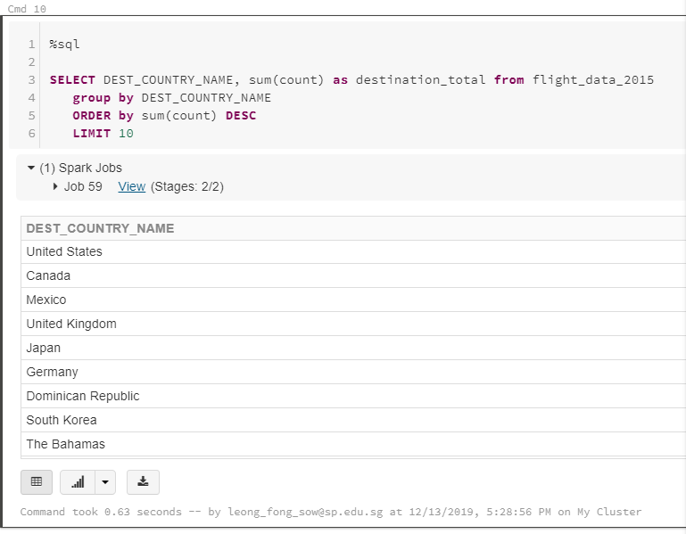
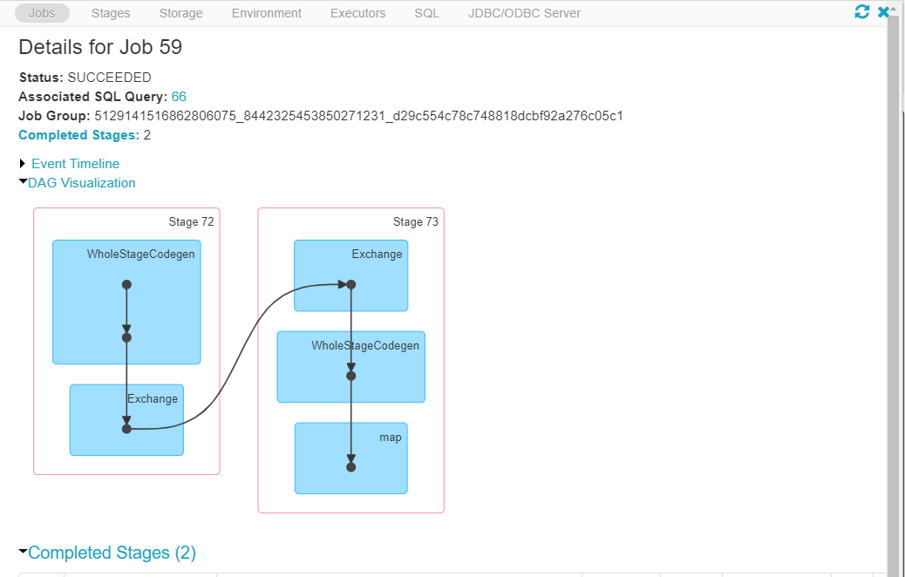

Slide 19
SPARK SQL – LAZY Evaluation
Execute transformation statements only when there is an action executed on the resulting RDDs.
Whenever Spark executes a batch, it comes up with an execution plan that optimizes full resources and memory based on the statements it has to execute.

Slide 20

Overview of Databricks Community Edition

Slide 21
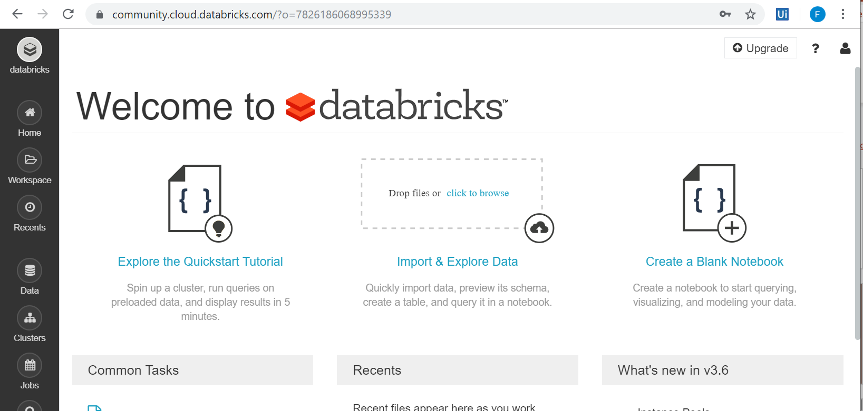
Databricks Community Edition
Notes:
Plan: Have a quick demo and ask to student create an account and do the first practical.

Slide 22
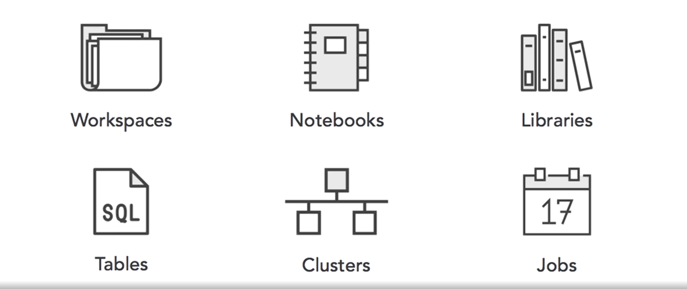
Overview of Databricks Community Edition
Notes:
Teaching Notes: Demo one practical for them to learn quickly the interface

Slide 23
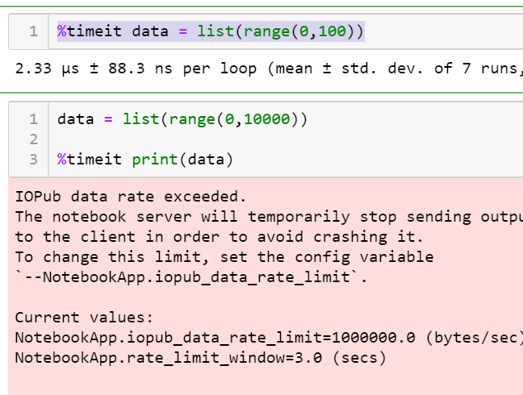
Jupiter Notebook at local Machine
Notes:
The slide and next to illustrate the limitation of a local computer.

Slide 24
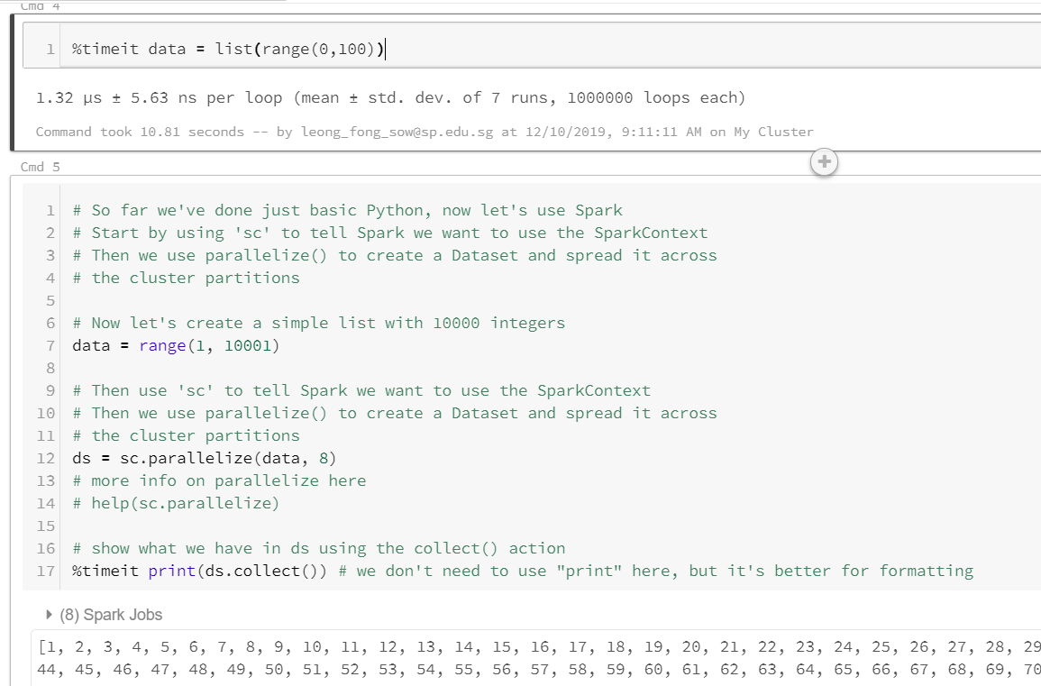
Databricks notebook(python)

Slide 25
Spark SQL
With Spark SQL, we can run SQL quires against views or table organization.
Spark implements subset of ANSI SQL:2003.
Spark is intended to operate as an online analytic processing (OLAP) database, not as an online transaction processing (OLTP).

Slide 26
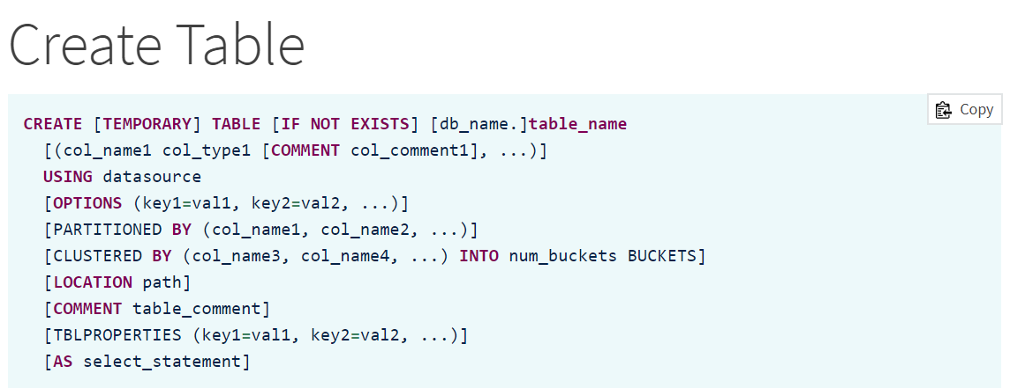
SPARK SQL: Create table
Notes:
The Spark SQL Create Table – from a variety of data sources (CSV, JSON). – Using clause
The Practical will illustrate more of these options.

Slide 27
SPARK SQL: Window functions
To carry out some unique aggregations by computing some aggregation on a specific “window” of data.
The “window” of data is defined using a reference to the current data.
The window specification is marked by the ‘Over (…)’ clause.

Slide 28
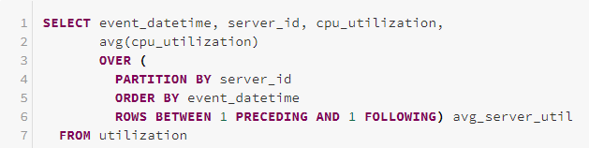
SPARK SQL: Window functions – Example
Partition Specification
Ordering Specification
Frame Specification (Rows …)
Notes:
Source: https://databricks.com/blog/2015/07/15/introducing-window-functions-in-spark-sql.html
A window specification includes three parts:
Partitioning Specification: controls which rows will be in the same partition with the given row. Also, the user might want to make sure all rows having the same value for the category column are collected to the same machine before ordering and calculating the frame. If no partitioning specification is given, then all data must be collected to a single machine.
Ordering Specification: controls the way that rows in a partition are ordered, determining the position of the given row in its partition.
Frame Specification: states which rows will be included in the frame for the current input row, based on their relative position to the current row. For example, “the three rows preceding the current row to the current row” describes a frame including the current input row and three rows appearing before the current row.

Slide 29
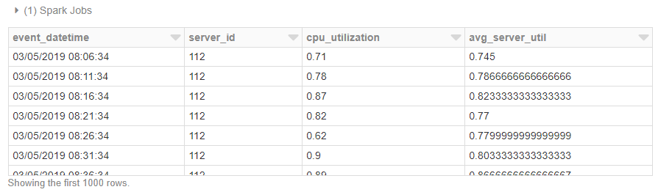
SPARK SQL: Window functions – Example
Notes:
Source: https://databricks.com/blog/2015/07/15/introducing-window-functions-in-spark-sql.html
A window specification includes three parts:
Partitioning Specification: controls which rows will be in the same partition with the given row. Also, the user might want to make sure all rows having the same value for the category column are collected to the same machine before ordering and calculating the frame. If no partitioning specification is given, then all data must be collected to a single machine.
Ordering Specification: controls the way that rows in a partition are ordered, determining the position of the given row in its partition.
Frame Specification: states which rows will be included in the frame for the current input row, based on their relative position to the current row. For example, “the three rows preceding the current row to the current row” describes a frame including the current input row and three rows appearing before the current row.

Slide 30
THE END

